Slide 1
ACACES 2018 Summer School GPU Architectures: Basic to Advanced Concepts
Adwait Jog, Assistant Professor
College of William & Mary (http://adwaitjog.github.io/)
Slide Credits: NVIDIA Teaching Kit, Tor Aamodt (UBC)

Slide 2
William & Mary
Second oldest-institution of higher education in the USA
Located in Williamsburg, VA, USA. Recently hosted ASPLOS conference – one of the top venues for computer architecture research.
I am affiliated with Computer Science Department
Graduate Program (~65-70 Ph.D. students)
25 Faculty Members
Many graduated Ph.D. students have successfully established careers in academia & industry.

Slide 3

Brief Introduction
Interested in developing high-performance, energy-efficient and scalable systems that are low cost, reliable, and secure.
Special focus on GPU architectures and accelerators.
Adwait Jog
(Assistant Professor)
I lead Insight Computer Architecture
Lab at College of William and Mary
(http://insight-archlab.github.io/)
Our lab is funded by
US National Science Foundation and always looking to hire bright students at all levels.

Slide 4
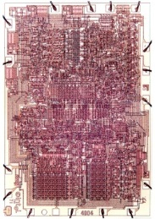
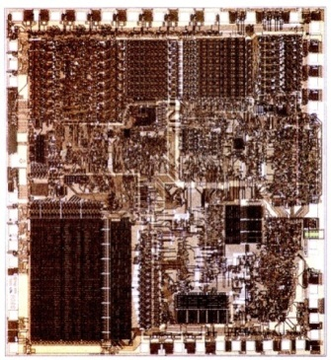
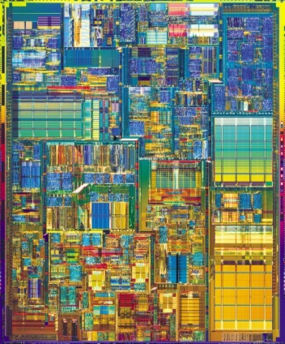
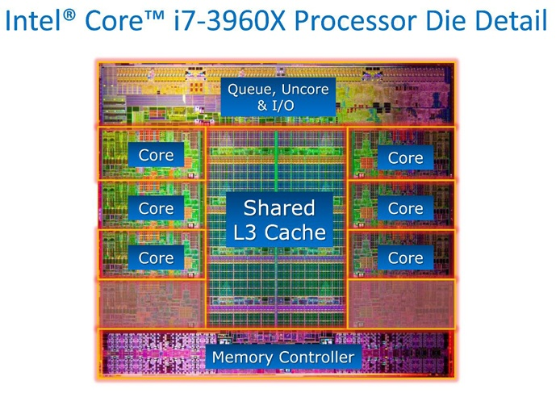
Journey of CMPs: Scaling and Heterogeneity Trends
Intel 4004,
1971
1 core,
no cache
23K transistors
Intel 8088,
1978
1 core,
no cache
29K transistors
Intel Pentium 4,
2000
1 core
256 KB L2 cache
42M transistors
Intel Sandy Bridge,
2011
6 cores
15 MB L3 cache
2270M transistors
What’s now?

Slide 5
Intel Core i7-6700K Processor, 2016 (SKYLAKE)
1.7 billion transistors, 14 nm process, die size 122 mm²
“Skylake”
Notes:
image source probably Intel, available at many places

Slide 6
Intel Quad Core GT2, 2017 (Kaby Lake)
14 nm process, die size 126 mm²

Slide 7
Heterogeneous Architectures (2018)
Intel Coffee Lake and
Kaby Lake
AMD Raven Ridge

Slide 8
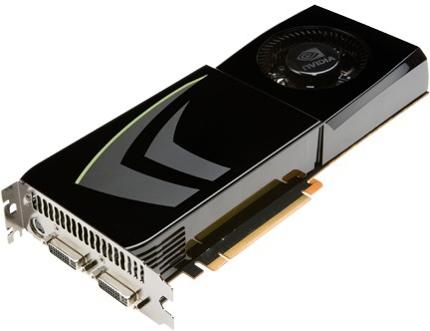

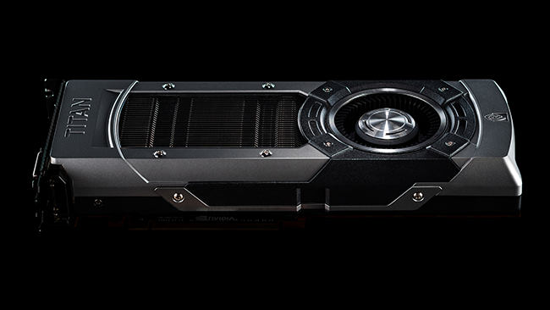
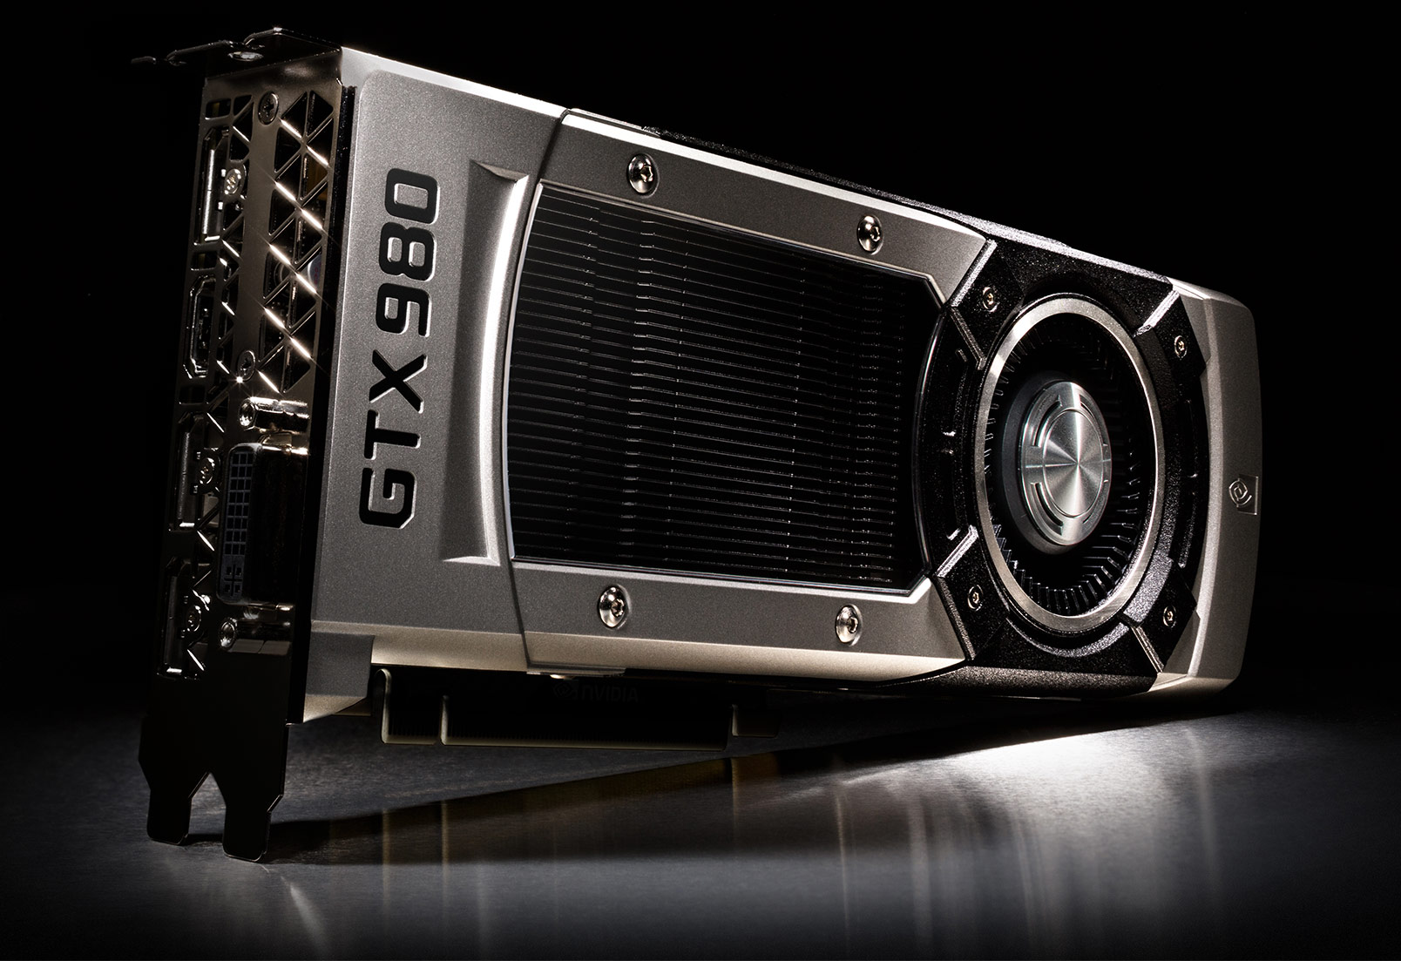
Discrete GPU Cards --- Scaling Trends
2008 2010 2012 2014 2016 2018
GTX 275
(Tesla)
240
CUDA
Cores
(127
GB/sec)
GTX 480
(Fermi)
448
CUDA
Cores
(139
GB/sec)
GTX 680
(Kepler)
1536
CUDA
Cores
(192
GB/sec)
GTX 980
(Maxwell)
2048
CUDA
Cores
(224
GB/sec)
GP 100
(Pascal)
3584
CUDA
Cores
(720
GB/sec)
GV 100
(Volta)
5120
CUDA
Cores
(900
GB/sec)
Notes:
As we know GPU are scaling both in terms of number of CUDA cores as well peak DRAM
Bandwidth. For example, the latest NVIDIA GPU GTX 980 has more than 2000 cores.
Given such powerful GPUs, the question is -- Are we “still” using them efficiently?

Slide 9






GPUs are Ubiquitous

Slide 10




And… other places
HELPS UNDERSTAND UNIVERSE
BACKEND OF “Google”
&
many others
ENABLING
Scientific COMPUTING
&
BREAKTHROUGHS

Slide 11
Why use a GPU for computing?
GPU uses larger fraction of silicon for computation than CPU.
At peak performance GPU uses order of magnitude less energy per operation than CPU.
Rewrite Application
GPU
200pJ/op
CPU
2nJ/op
Order of Magnitude More Energy Efficient
However….
Application must perform well

Slide 12
GPU vs. CPU
Control
ALU
ALU
ALU
ALU
Cache
CPU Memory
GPU Memory
CPU
GPU

Slide 13
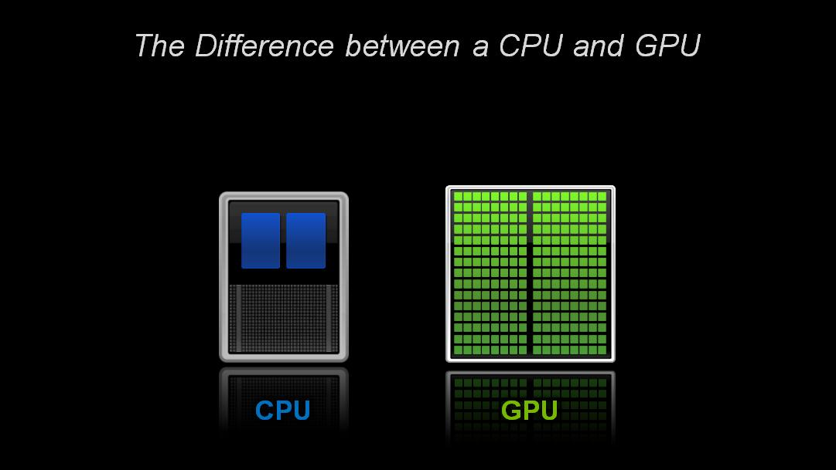
How Acceleration Works
Application Code
Sequential Code
Parallel Code
Sequential Code
Accelerator
(e.g., GPU)
Many Top 20 supercomputers
in the green500 list employ accelerators.
Fewer Cores
Large Number of Cores
Optimized for Latency
Optimized for Throughput
Great for Sequential Code
Great for
Parallel Code
Notes:
Do not use the word “offload”

Slide 14

SUMMIT Super Computer
Multiple Volta GPUs
NVLink
HBM + DDR4
https://www.olcf.ornl.gov/olcf-resources/compute-systems/summit/

Slide 15



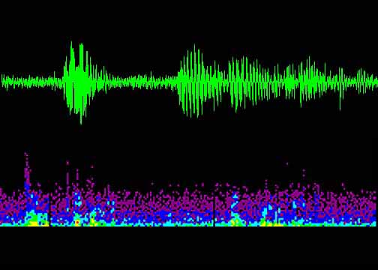





Making Good Use of Resources (1)
Astronomy
Medical
Imaging
Physics
Simulation
Audio
Processing
Machine
Learning
Data-Level Parallelism
Large
Data Sets
Image Processing
Financial Computing
Genomics
Games

Slide 16
Making Good Use of Resources (2)
Deep Learning and Artificial Intelligence
Credit: NVIDIA AI
However, there are several compute and memory bottlenecks in GPU-based systems that need to be addressed via software- and/or hardware-based solutions

Slide 17
Course Outline
Lectures 1 and 2: Basics Concepts
Basics of GPU Programming
Basics of GPU Architecture
Lecture 3: GPU Performance Bottlenecks
Memory Bottlenecks
Compute Bottlenecks
Possible Software and Hardware Solutions
Lecture 4: GPU Security Concerns
Timing channels
Possible Software and Hardware Solutions

Slide 18
Course Outline
Lectures 1 and 2: Basics Concepts
Basics of GPU Programming
Basics of GPU Architecture
Lecture 3: GPU Performance Bottlenecks
Memory Bottlenecks
Compute Bottlenecks
Possible Software and Hardware Solutions
Lecture 4: GPU Security Concerns
Timing channels
Possible Software and Hardware Solutions

Slide 19
Course Objectives
By the end of this (short) course, I hope you can appreciate
the benefits of GPUs
the architectural differences between CPU and GPU
the key research challenges in the context of GPUs
some of the existing research directions
I encourage questions during and after the class
Ample time for discussions during the week

Slide 20
Background
My assumption is that students have some background on basic computer organization and design.
Question 1: How many of you have taken undergraduate-level course on computer architecture?
Question 2: How many of you have taken graduate-level course on computer architecture?
Question 3: How many of you have taken a GPU course before?

Slide 21
Reading Material (Books & Docs)
D. Kirk and W. Hwu, “Programming Massively Parallel Processors – A Hands-on Approach, 3rd Edition”
Patterson and Hennesy, Computer Organization and Design, 5th Edition, Appendix C-2 on GPUs
Aamodt, Fung, Rogers, “General-Purpose Graphics Processing Architectures” – Morgan & Claypool Publishers, 1st Edition (New book!)
Nvidia CUDA C Programming Guide
https://docs.nvidia.com/cuda/cuda-c-programming-guide/

Slide 22
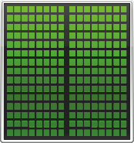

How is this system programmed (today)?
CPU Memory
GPU Memory
CPU GPU

Slide 23
GPU Programming Model
+
CPU (host) “off-load” parallel kernels to GPU (device)
Transfer data to GPU memory
GPU spawns threads
Need to transfer result data back to CPU main memory
CPU
CPU
CPU
spawn
spawn
done
GPU
GPU
Time

Slide 24
CUDA Execution Model
Application Code
Serial parts (C code) in CPU (host)
Parallel parts (Kernel code) in GPU (device)
Application
Serial Code (host)‏
Parallel Kernel (device)‏
KernelA<<< nBlk, nTid >>>(args);
. . .
Serial Code (host)‏
Parallel Kernel (device)‏
KernelB<<< nBlk, nTid >>>(args);
. . .
Serial Code (host)‏

Slide 25
GPGPU Application Hierarchy
Application
Kernel
CTA
Warp 1
Kernel 1
Block 1
Warp 2
Threads
Warp 3
Block 2
Warp 4
Kernel 2
Block 3
Kernel 3

Slide 26
Arrays of Parallel Threads
A CUDA kernel is executed by a grid of threads
All threads in a grid run the same kernel code (Single Program Multiple Data)‏
Each thread has indexes that it uses to compute memory addresses and make control decisions
Thread Block 0
Thread Block 1
Thread Block N-1
0
1
2
254
255
0
1
2
254
255
0
1
2
254
255
…
…
…
i = blockIdx.x * blockDim.x + threadIdx.x;
C[i] = A[i] + B[i];
i = blockIdx.x * blockDim.x + threadIdx.x;
C[i] = A[i] + B[i];
i = blockIdx.x * blockDim.x + threadIdx.x;
C[i] = A[i] + B[i];
…
…
…
…

Slide 27
Quick Example

Slide 28
Vector Addition Example
vector A
A[0]
A[1]
A[2]
…
A[N-1]
vector B
B[0]
B[1]
B[2]
…
B[N-1]
+
+
+
+
vector C
C[0]
C[1]
C[2]
…
C[N-1]

Slide 29
Vector Addition – Traditional C Code
// Compute vector sum C = A + B
void vecAdd(float *h_A, float *h_B, float *h_C, int n)
{
int i;
for (i = 0; i<n; i++) h_C[i] = h_A[i] + h_B[i];
}
int main()
{
// Memory allocation for h_A, h_B, and h_C
// I/O to read h_A and h_B, N elements
…
vecAdd(h_A, h_B, h_C, N);
}

Slide 30
vecAdd CUDA Host Code
#include <cuda.h>
void vecAdd(float *h_A, float *h_B, float *h_C, int n)‏
{
int size = n* sizeof(float);
float *d_A, *d_B, *d_C;
// Part 1
// Allocate device memory for A, B, and C
// copy A and B to GPU (device) memory
// Part 2
// Kernel launch code – the device performs the vector addition
// Part 3
// copy C from the device memory
// Free device vectors
}

Slide 31
Vector Addition (Host Side)
void vecAdd(float *h_A, float *h_B, float *h_C, int n)
{
int size = n * sizeof(float); float *d_A, *d_B, *d_C;
cudaMalloc((void **) &d_A, size);
cudaMalloc((void **) &d_B, size);
cudaMalloc((void **) &d_C, size);
cudaMemcpy(d_A, h_A, size, cudaMemcpyHostToDevice);
cudaMemcpy(d_B, h_B, size, cudaMemcpyHostToDevice);
// Kernel invocation code – to be shown later
cudaMemcpy(h_C, d_C, size, cudaMemcpyDeviceToHost);
// do processing of results
cudaFree(d_A); cudaFree(d_B); cudaFree (d_C);
}

Slide 32
Kernel Invocation code (Host Side)
void vecAdd(float *h_A, float *h_B, float *h_C, int n)
{
….. Preparation code (See previous slide)
int blockSize, gridSize;
// Number of threads in each thread block
blockSize = 1024;
// Number of thread blocks in grid
gridSize = (int)ceil((float)n/blockSize);
// Execute the kernel
vecAdd<<<gridSize, blockSize>>>(d_A, d_B, d_C, n);
… Post-processing (See previous slide)
}

Slide 33
Kernel Code (Device Side)
__global__ void vecAdd(double *a, double *b, double *c, int n)
{
// Get our global thread ID
int id = blockIdx.x*blockDim.x+threadIdx.x;
// Make sure we do not go out of bounds
if (id < n)
c[id] = a[id] + b[id];
}
Same code is run by several threads

Slide 34
Important CUDA Syntax Extensions
Declaration specifiers
__global__ void foo(...); // kernel entry point (runs on GPU)
Syntax for kernel launch
foo<<<500, 128>>>(...); // 500 thread blocks, 128 threads each
Built in variables for thread identification
dim3 threadIdx; dim3 blockIdx; dim3 blockDim;

Slide 35
Example: Original C Code
void saxpy_serial(int n, float a, float *x, float *y)
{
for (int i = 0; i < n; ++i)
y[i] = a*x[i] + y[i];
}
int main() {
// omitted: allocate and initialize memory
saxpy_serial(n, 2.0, x, y); // Invoke serial SAXPY kernel
// omitted: using result
}
Notes:
saxpy = single precision ax + y

Slide 36
CUDA Code
__global__ void saxpy(int n, float a, float *x, float *y) {
int i = blockIdx.x*blockDim.x + threadIdx.x;
if(i<n) y[i]=a*x[i]+y[i];
}
int main() {
// omitted: allocate and initialize memory
int nblocks = (n + 255) / 256;
cudaMalloc((void**) &d_x, n);
cudaMalloc((void**) &d_y, n);
cudaMemcpy(d_x,h_x,n*sizeof(float),cudaMemcpyHostToDevice);
cudaMemcpy(d_y,h_y,n*sizeof(float),cudaMemcpyHostToDevice);
saxpy<<<nblocks, 256>>>(n, 2.0, d_x, d_y);
cudaMemcpy(h_y,d_y,n*sizeof(float),cudaMemcpyDeviceToHost);
// omitted: using result
}
Runs on GPU
Notes:
saxpy = single precision ax + y

Slide 37
Code to Hardware Mapping: Transparent Scalability
Kernel
Block 0
Block 1
Case-1
Block 2
Block 3
Block 4
Block 5
Case-2
Block 6
Block 7
GPU-2 (Device - 2)
P
P
GPU-1 (Device - 1)
P
P
P
P
Block 0
Block 1
Block 2
Block 3
Block 0
Block 1
Block 2
Block 3
Block 4
Block 5
Block 4
Block 5
Block 6
Block 7
Block 6
Block 7
Each block can execute in any order relative to others.
GPU Hardware is free to assign blocks to any processor at any time
➔ A kernel scales to any number of parallel processors.

Slide 38
Code to Hardware Mapping: Transparent Scalability
Kernel
Block 0
Block 1
Case-1
Block 2
Block 3
Block 4
Block 5
Case-2
Block 6
Block 7
GPU-2 (Device - 2)
P
P
GPU-1 (Device - 1)
P
P
P
P
Block 0
Block 1
Block 0
Block 1
Block 2
Block 3
Block 2
Block 3
Block 4
Block 5
Block 6
Block 7
Block 4
Block 5
Block 6
Block 7
Each block can execute in any order relative to others.
GPU Hardware is free to assign blocks to any processor at any time
➔ A kernel scales to any number of parallel processors.

Slide 39
Streaming Multi-Processor (SM)
Control
SM
PE
PE
PE
PE
GPU-1 (Device - 1)
PE
PE
PE
PE
SM
SM
SM
SM
PE
PE
PE
PE
PE
PE
PE
PE
PE
PE
PE
PE
PE
PE
PE
PE
PE
PE
PE
PE
Scratchpad
PE
PE
PE
PE
Threads are assigned to SM in block granularity
SM maintains thread/block idx #s
SM manages/schedules thread execution
Multiple blocks can be allocated to the SM
Based on the amount of resources (shared memory, register file etc.)
Register File

Slide 40
GPU Execution Model
Blocks assigned to each SM are scheduled on the associated SIMD hardware (i.e., on the Processing Elements (PEs)).
SM bundles threads (from various blocks) into warps (wavefronts) and runs them in lockstep on across PEs.
An NVIDIA warp groups 32 consecutive threads together (AMD wave-fronts group 64 threads together)
Warps are:
Scheduling units in SM
Scheduled in multiplexed and pipelined manner on the SM
Notes:
MIMD = multiple-instruction, multiple-data

Slide 41
Warp Example
If 3 blocks are assigned to an SM and each block has 256 threads, how many warps are there in an SM?
Each Block is divided into 256/32 = 8 Warps
There are 8 * 3 = 24 Warps
…
Block 0 Warps
…
Block 1 Warps
…
…
…
Block 2 Warps
…
t0 t1 t2 … t31
t0 t1 t2 … t31
t0 t1 t2 … t31
Register File
Shared Memory

Slide 42
Tolerating Long Latencies
Execution in an SM
W3
Computation
W2
Waiting for Data from GPU Memory
W1
GPU attempts to hide long memory latency with computation from
other warps
How SMs are able to context switch between warps so quickly?

Slide 43
Summary
CPU spawns fork-join style “grid” of parallel threads
kernel()
thread block 0
thread block 1
thread block N
Spawns more threads than GPU can run (some may wait)
Organize threads into “blocks” (up to 1024 threads per block)
Each kernel is spawned containing 1 or more thread blocks.
Motivation: Write parallel software once and run on future hardware
Warps associated with blocks can help in tolerating long latencies.

Slide 44
Reading Material (Books & Docs)
D. Kirk and W. Hwu, “Programming Massively Parallel Processors – A Hands-on Approach, 3rd Edition”
Patterson and Hennesy, Computer Organization and Design, 5th Edition, Appendix C-2 on GPUs
Aamodt, Fung, Rogers, “General-Purpose Graphics Processing Architectures” – Morgan & Claypool Publishers, 1st Edition (New book!)
Nvidia CUDA C Programming Guide
https://docs.nvidia.com/cuda/cuda-c-programming-guide/

